Slide 1
Assessment 5 Data -1205 Visualizations ,Leadership
Ms. Nisha (100955146)
Ms. Anitha Babu (100944475)
Ms. Maisha Khatoon (100899259)

Slide 2
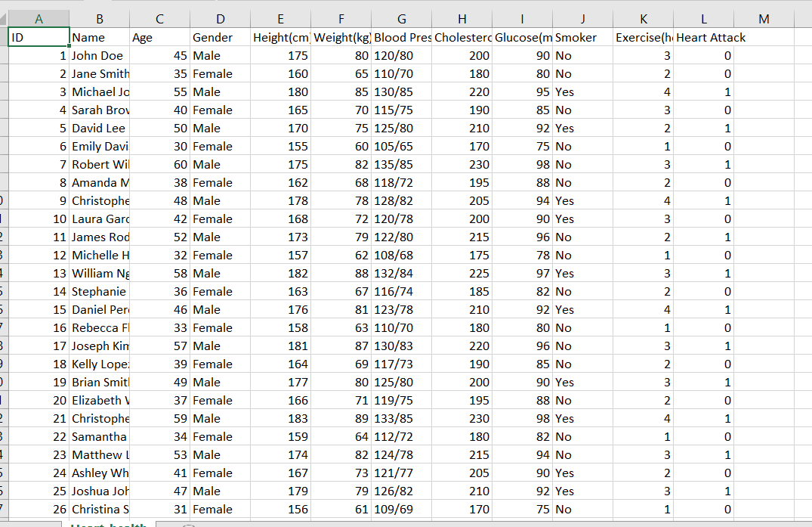
Introduction
This dataset includes individual heart health status indicators. It contains characteristics including age, gender, cholesterol, blood pressure, and whether or not the person has had a heart attack. The dataset is useful for evaluating the risk factors linked to heart disease and for trend analysis about cardiovascular health. Personalized therapies for heart disease prevention and management can be developed by researchers and healthcare professionals using this data to find patterns and create predictive models.
We found this from Kaggle data set

Slide 3
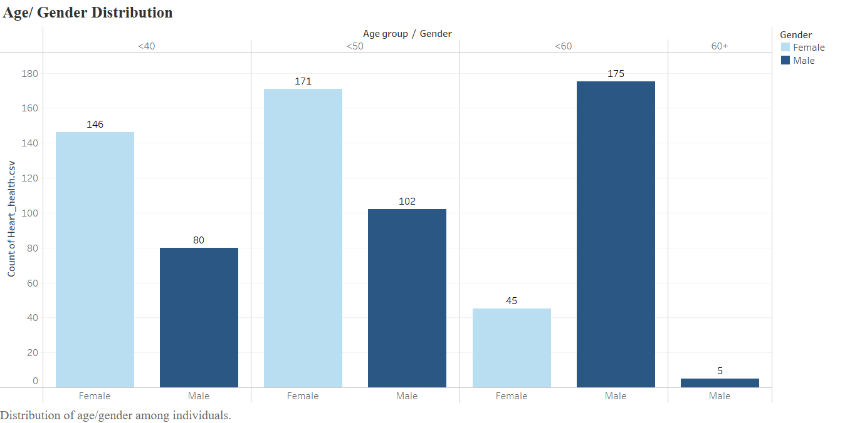

Slide 4
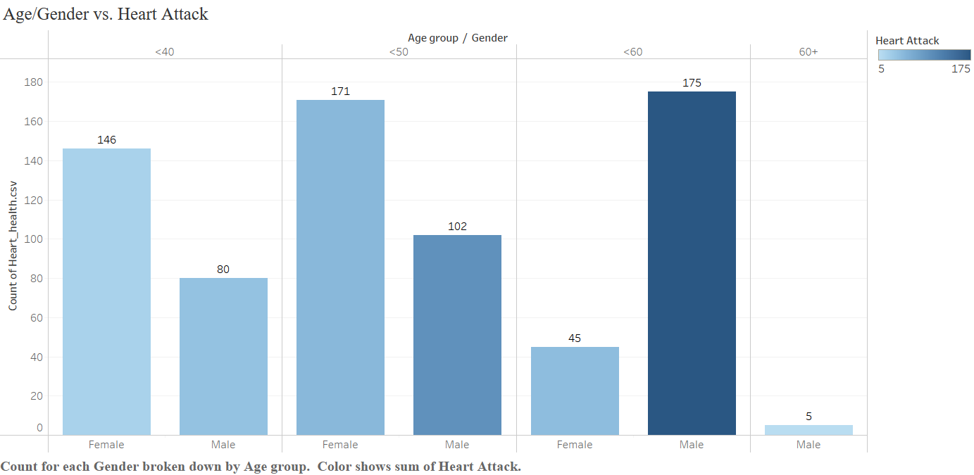

Slide 5
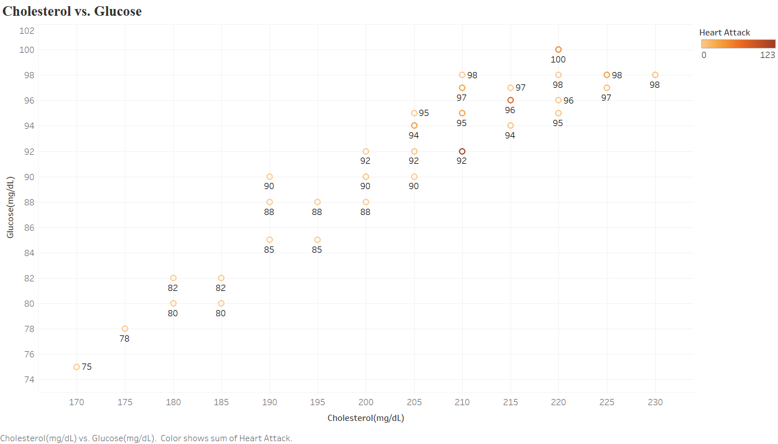

Slide 6
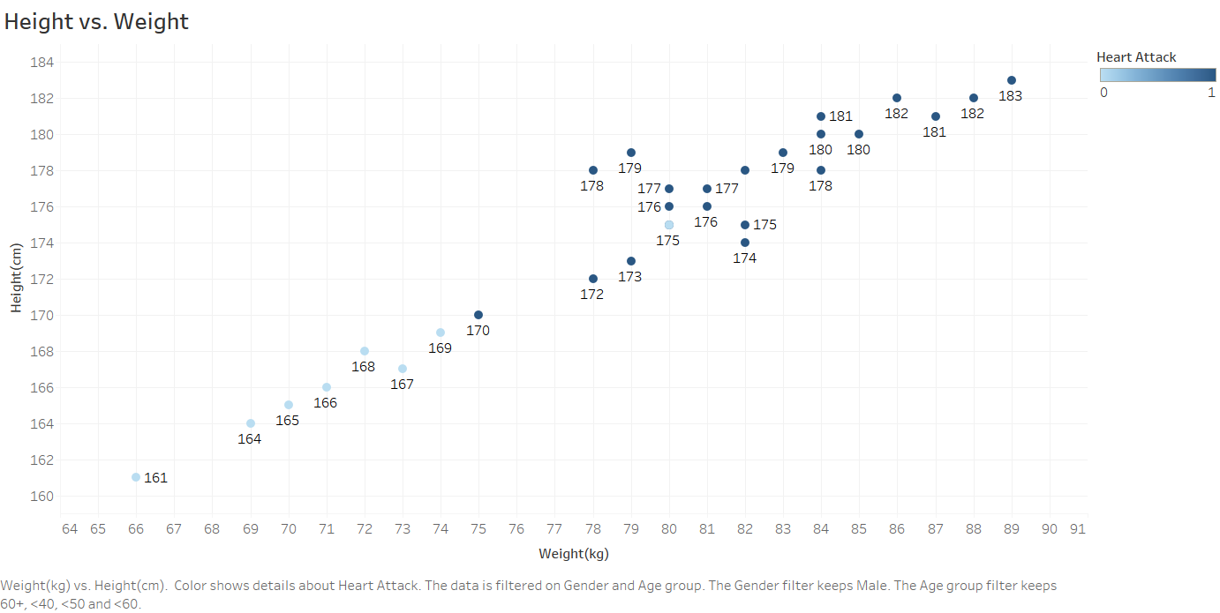

Slide 7
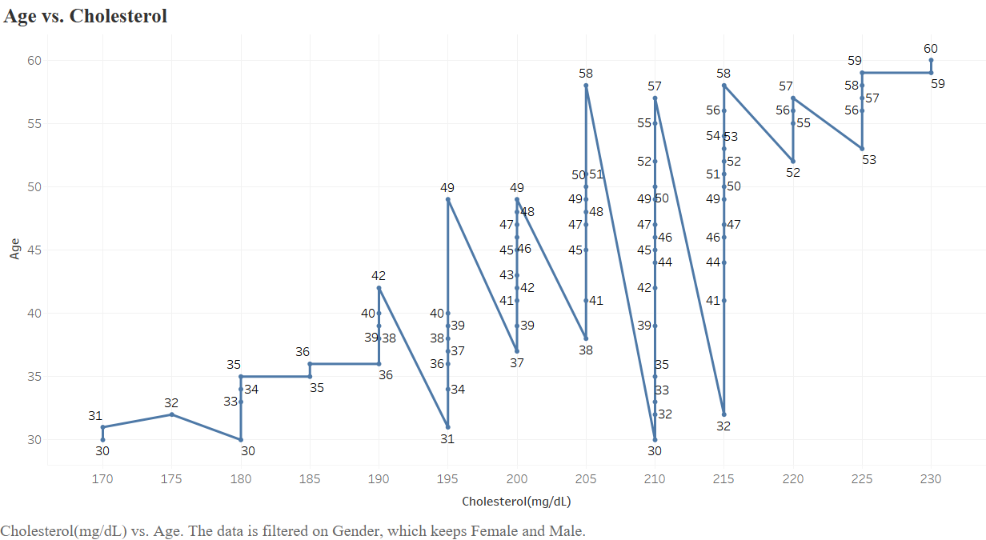

Slide 8
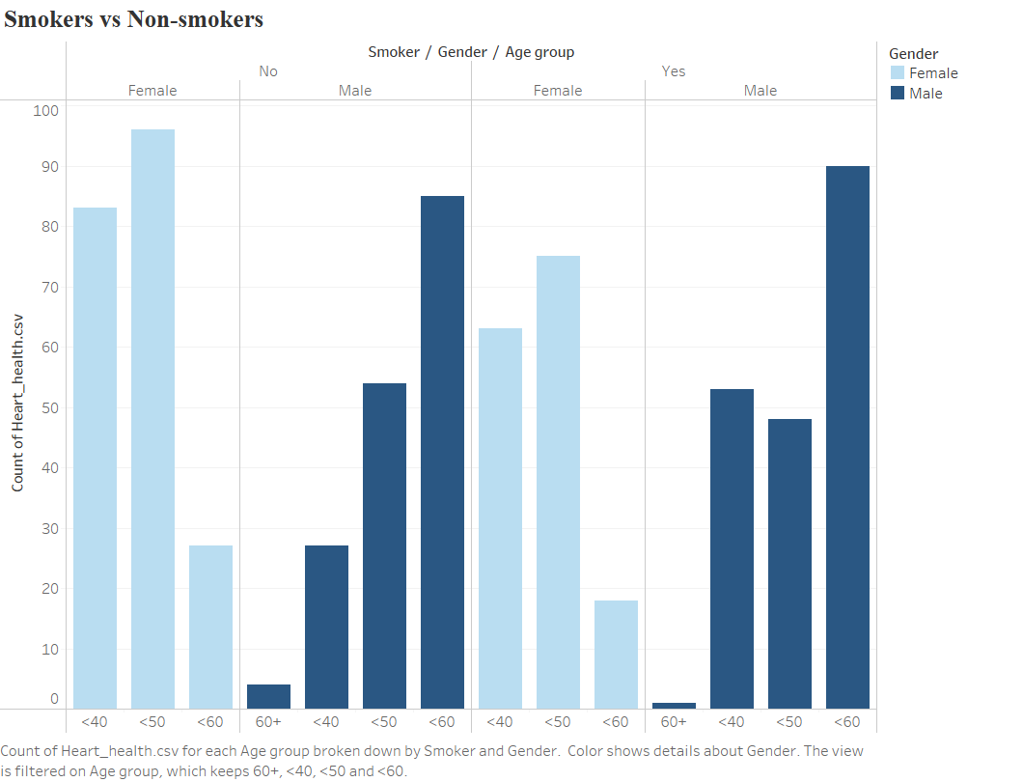

Slide 9
Conclusion
Based on the provided data, it appears that higher cholesterol levels are strongly associated with an increased risk of heart attack, particularly in older age groups and among males. Additionally, smoking status plays a significant role, with non-smokers generally exhibiting better heart health counts. Therefore, elevated cholesterol levels, especially in conjunction with smoking, seem to be a primary cause of heart attacks according to the data.

